Slide 1
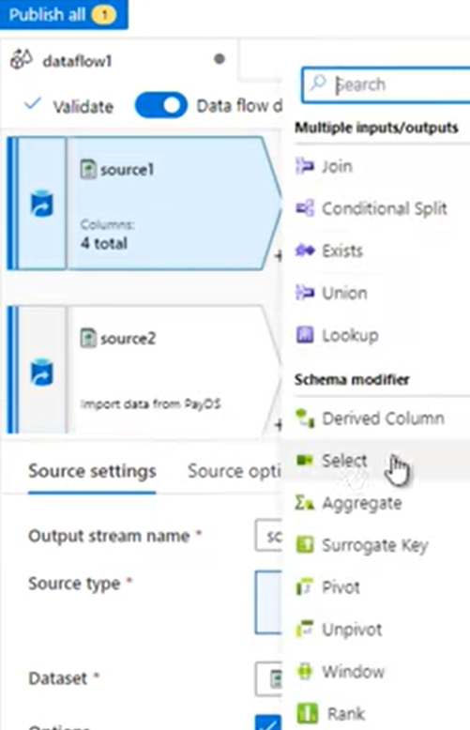

Slide 2
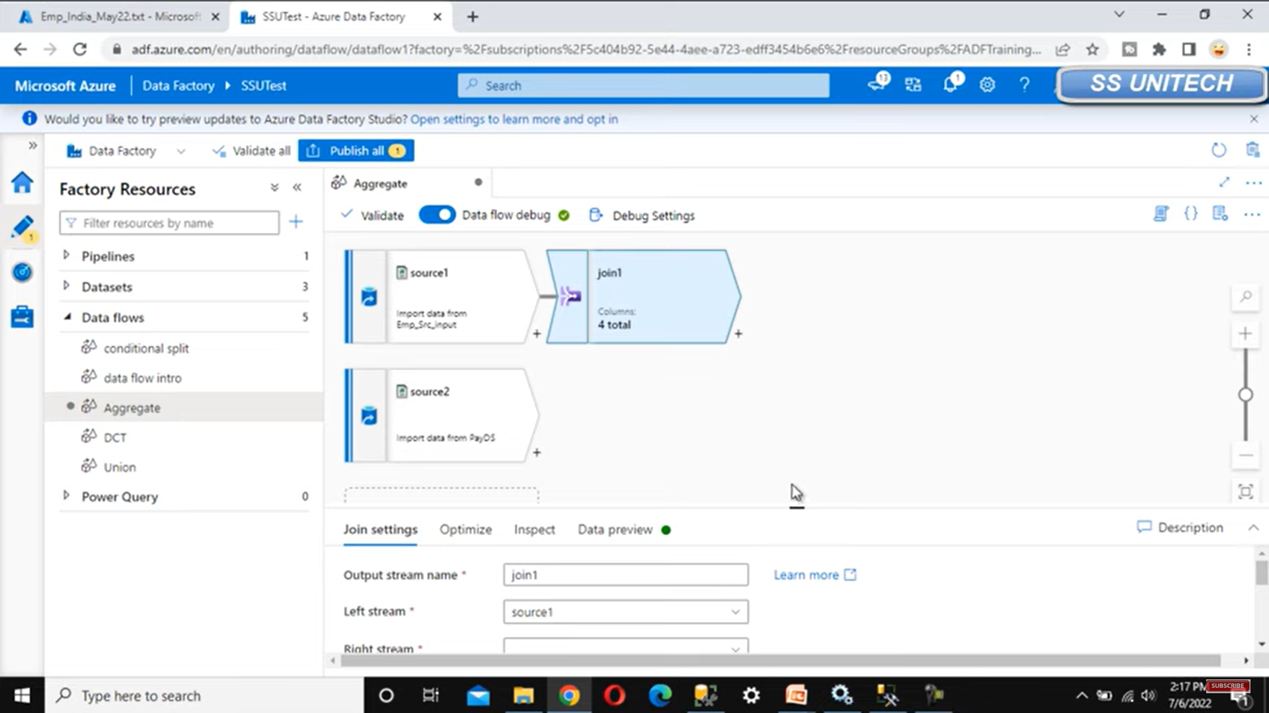
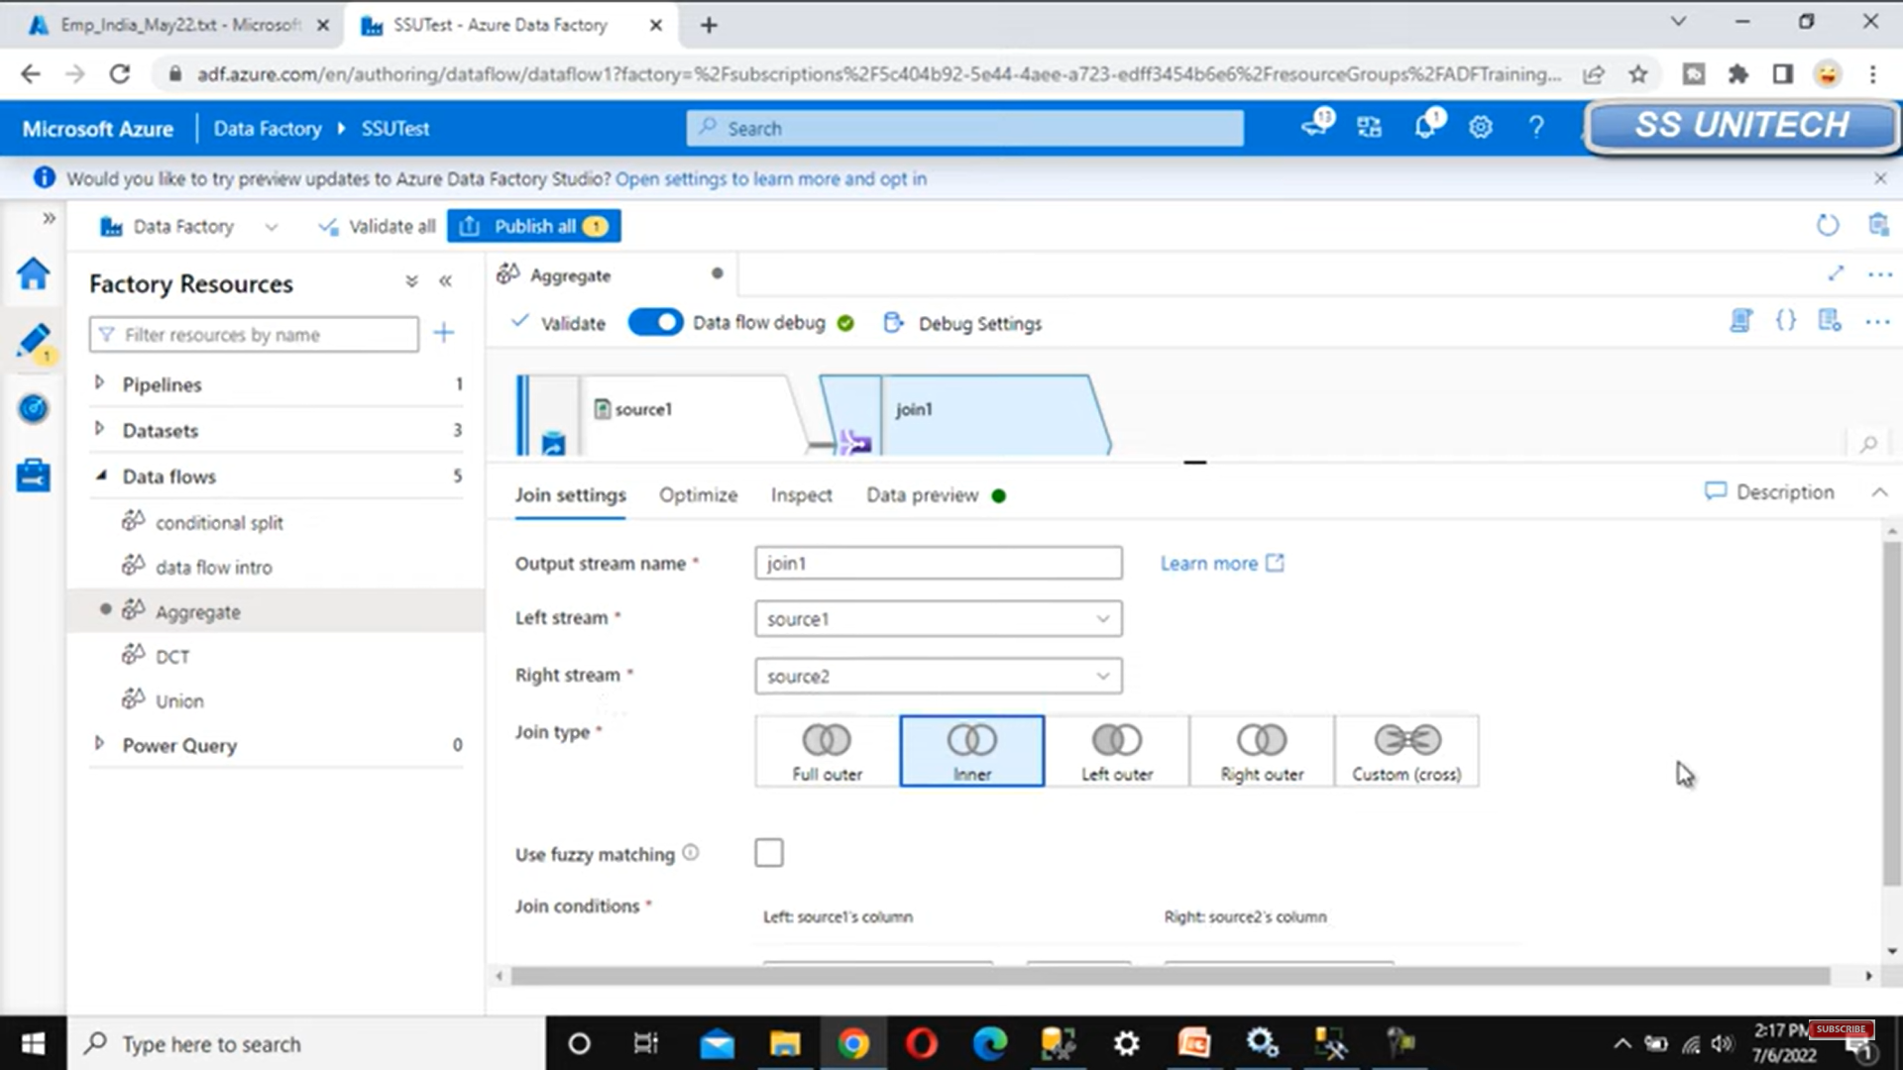
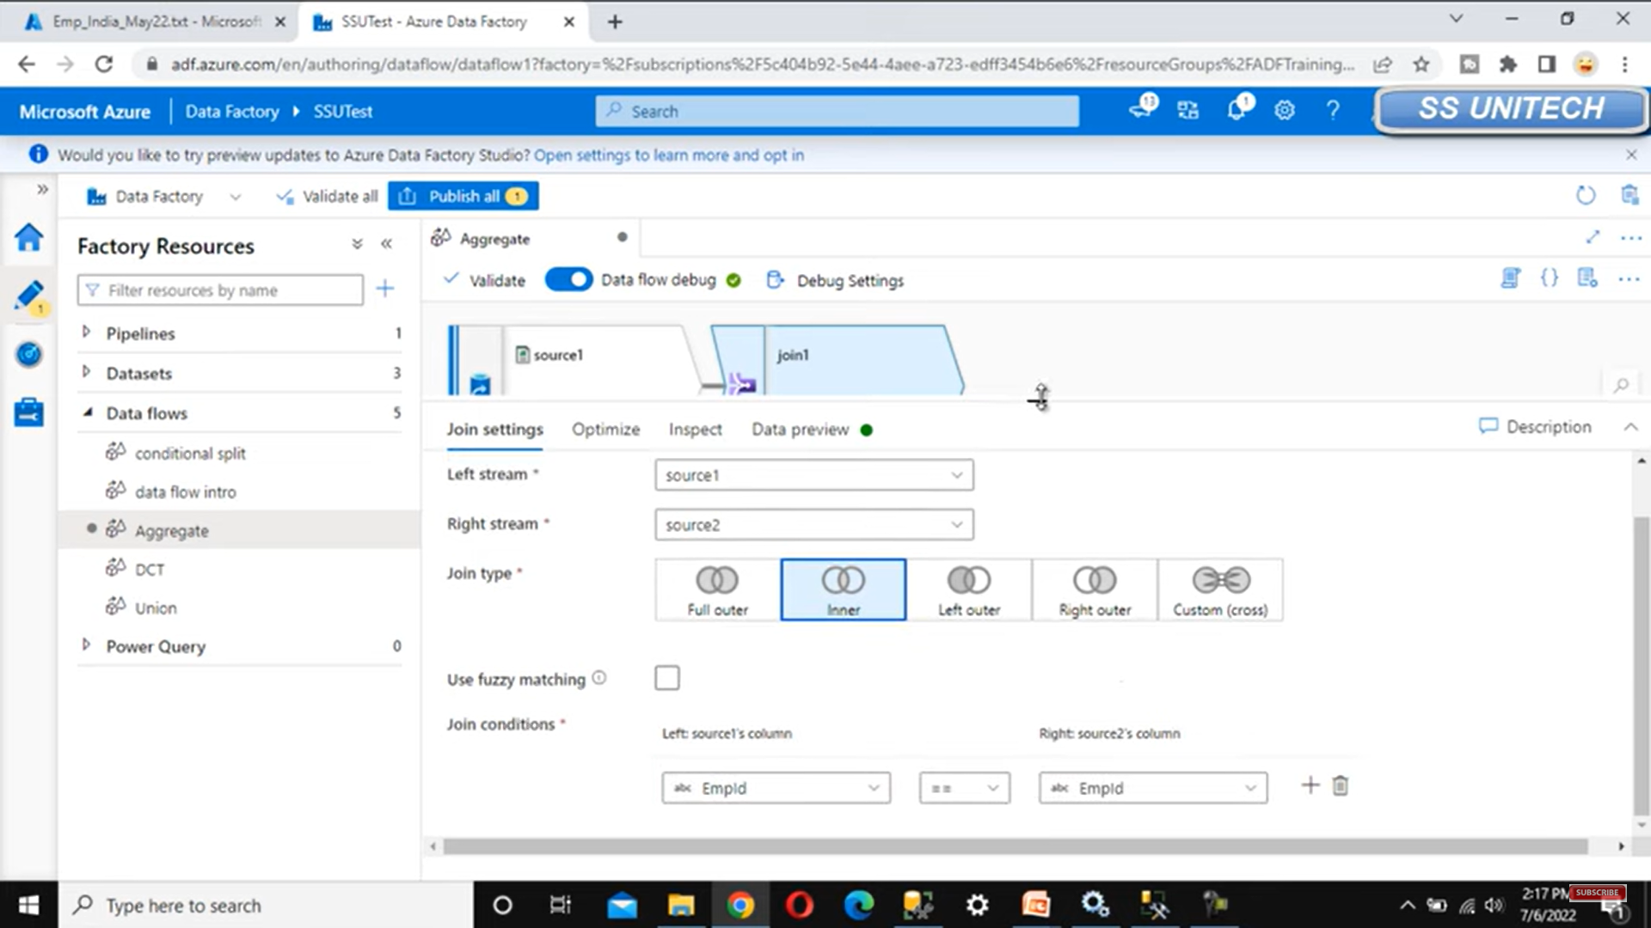

Slide 3
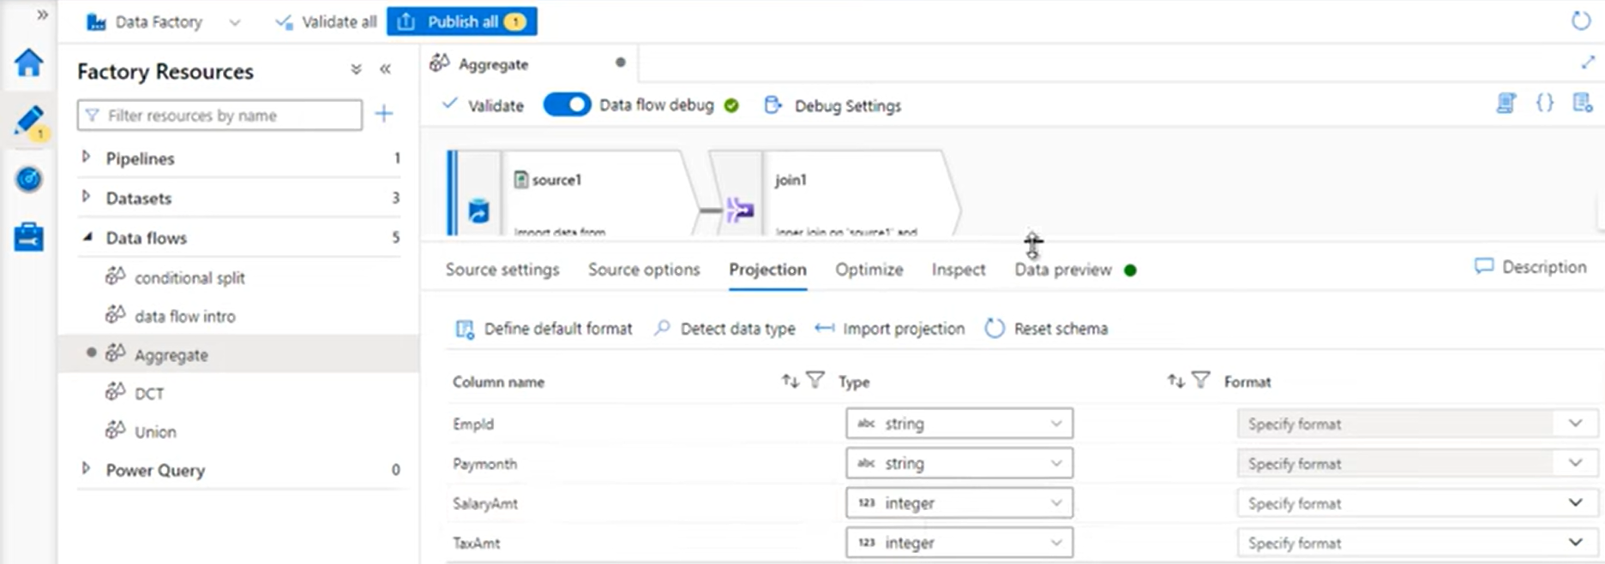
Click on source2 and under Projection, change the data type from string to integer

Slide 4
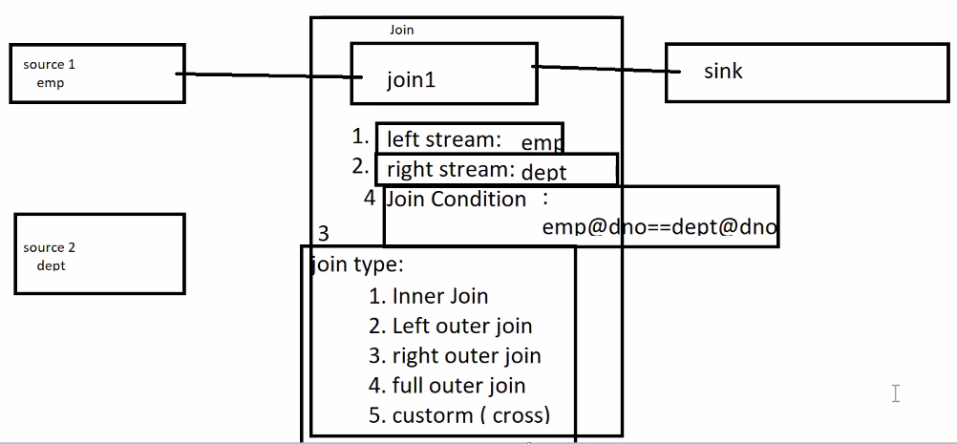

Slide 5
INNER JOIN

Slide 6
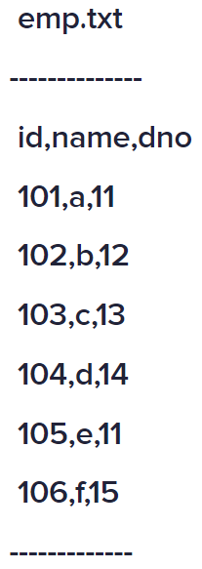
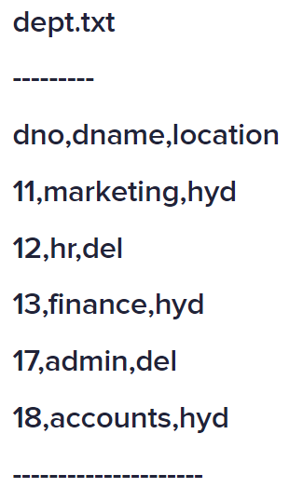
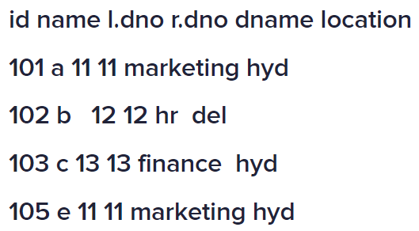

Slide 7
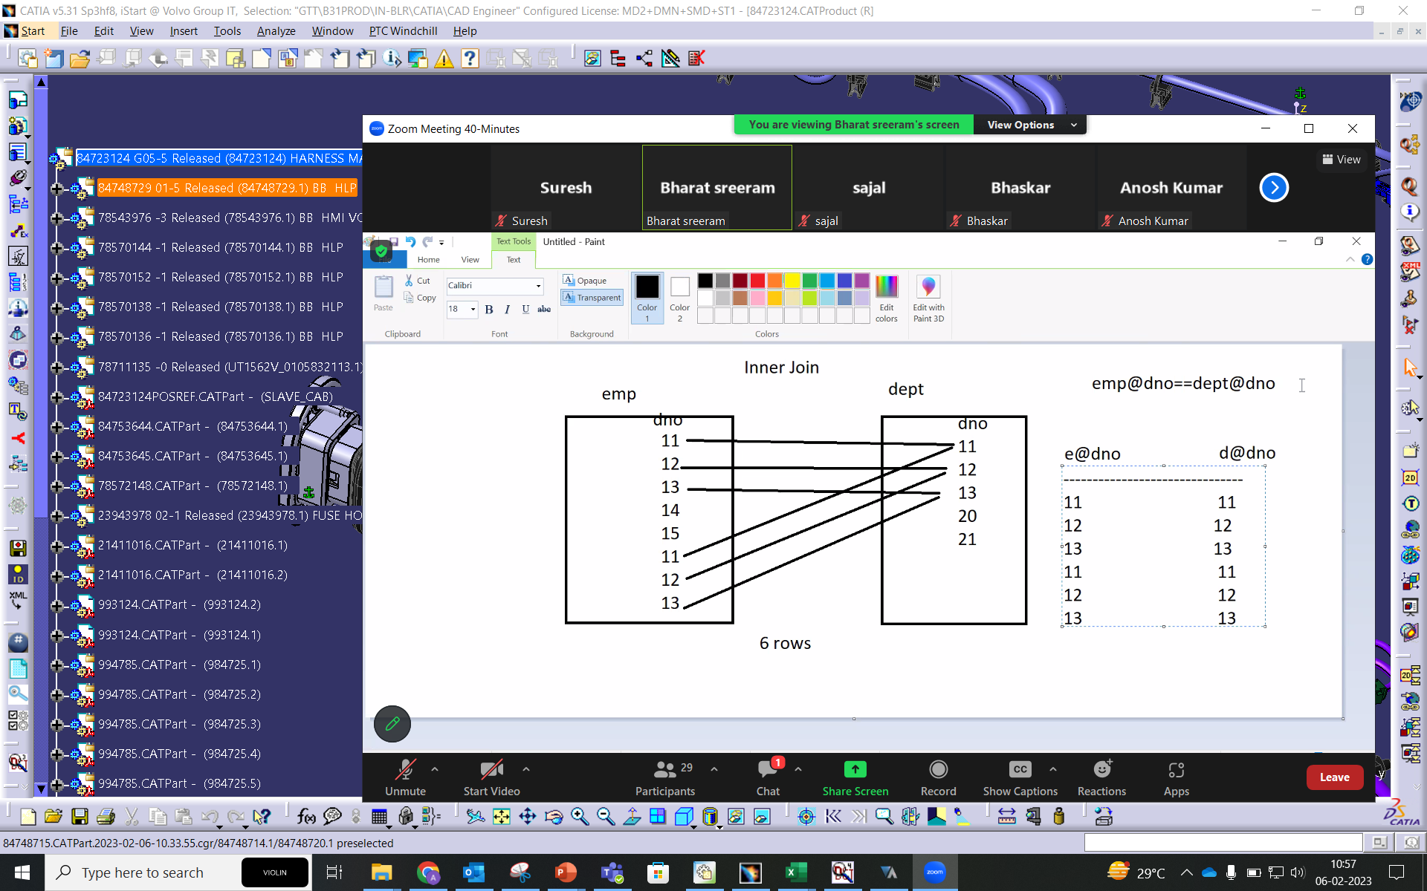
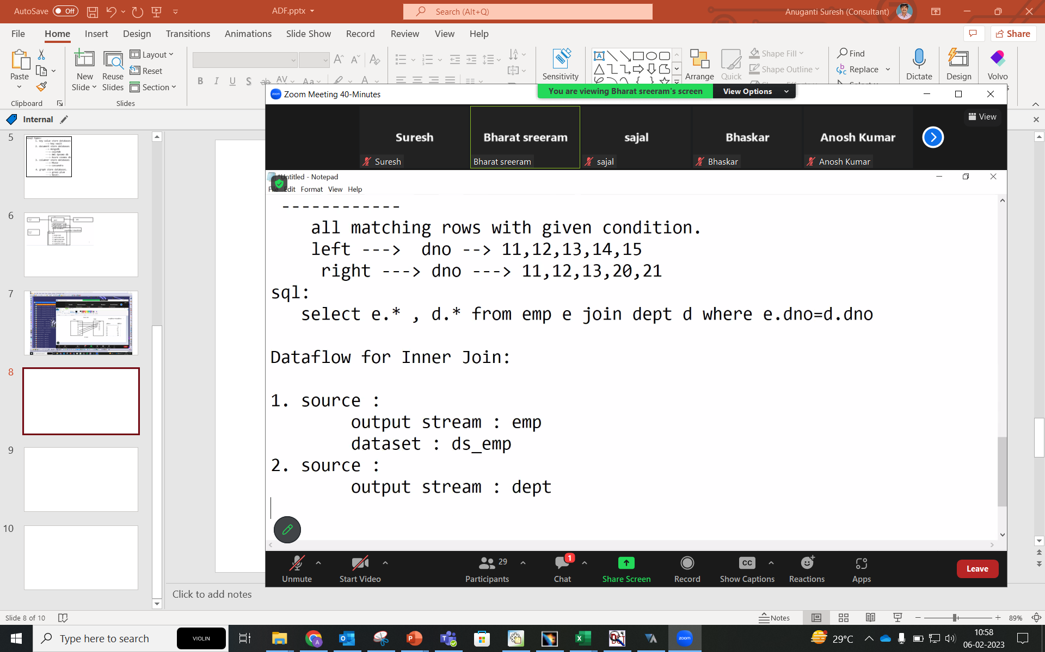
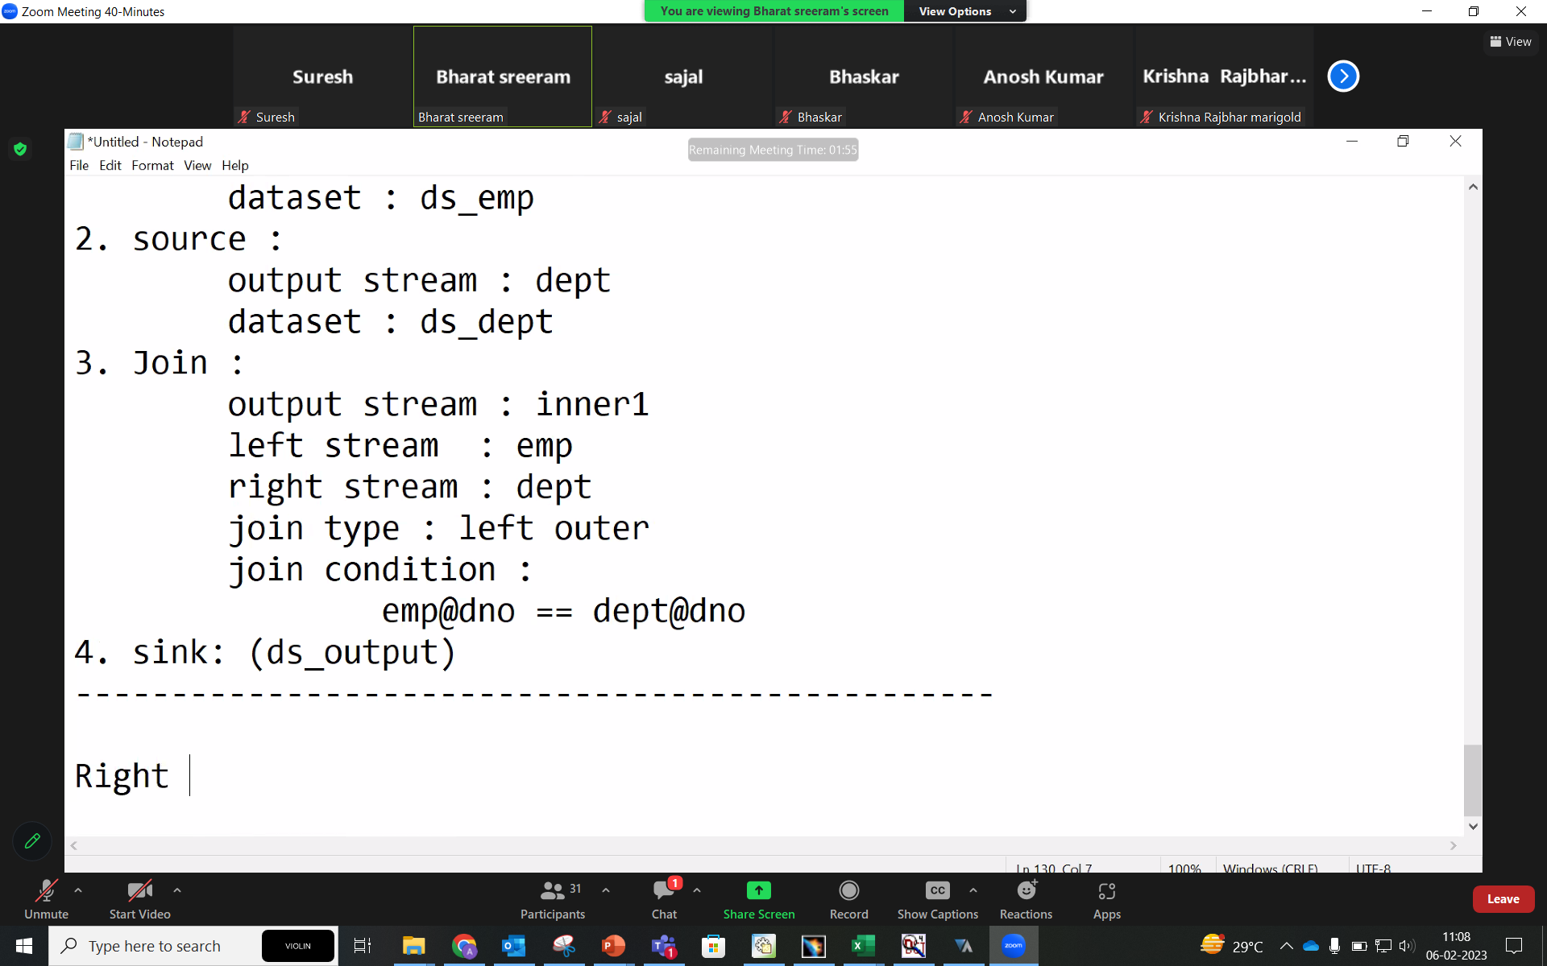
INNER JOIN

Slide 8
Left Outer JOIN

Slide 9
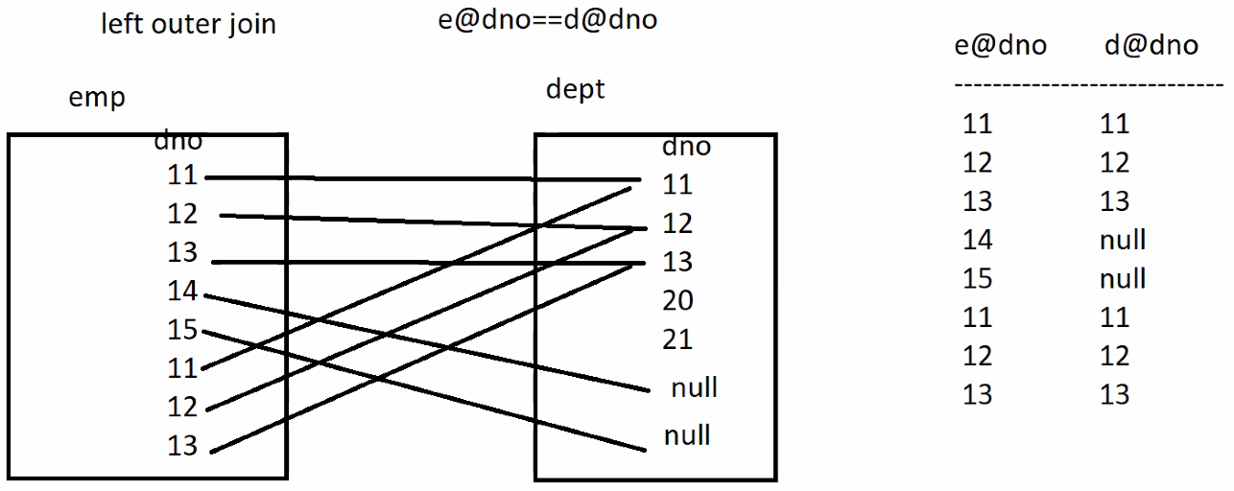
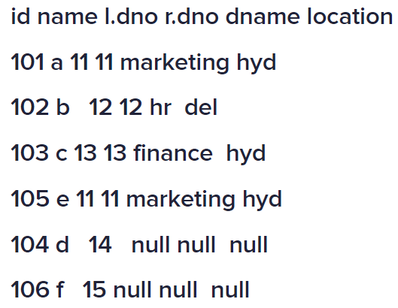

Slide 10
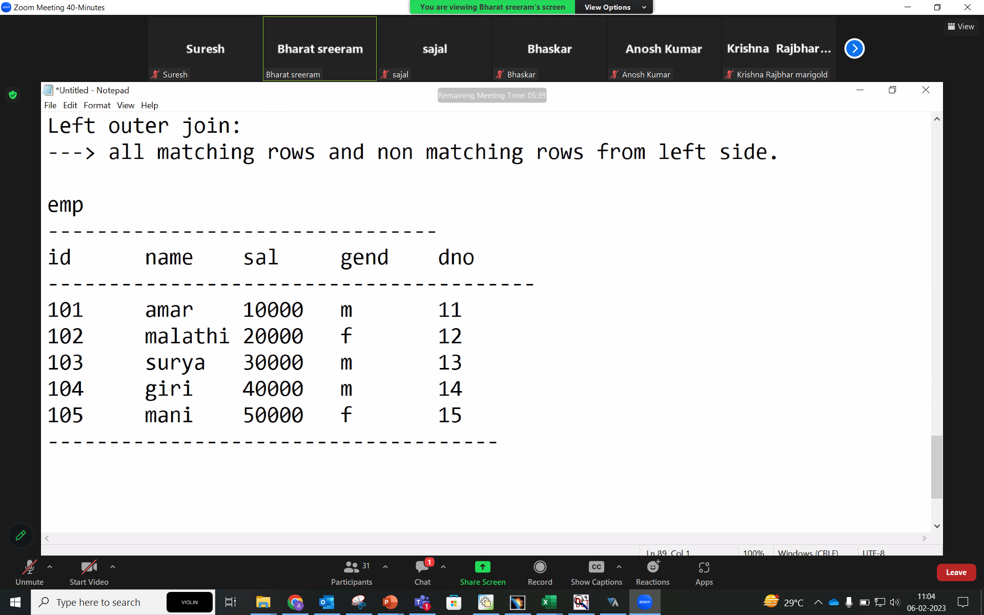
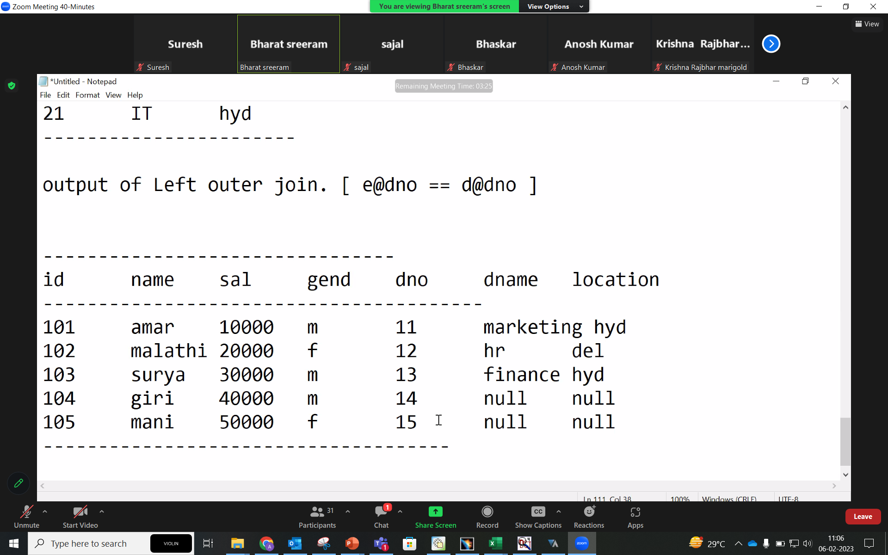
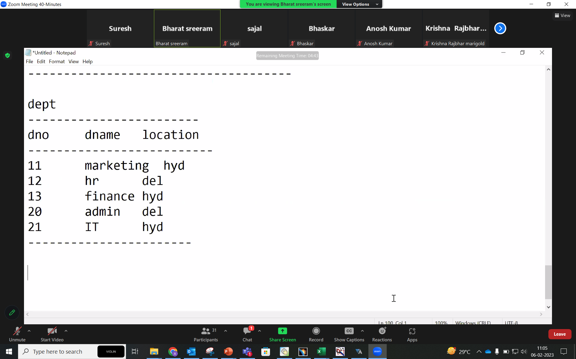

Slide 11
Right Outer JOIN

Slide 12
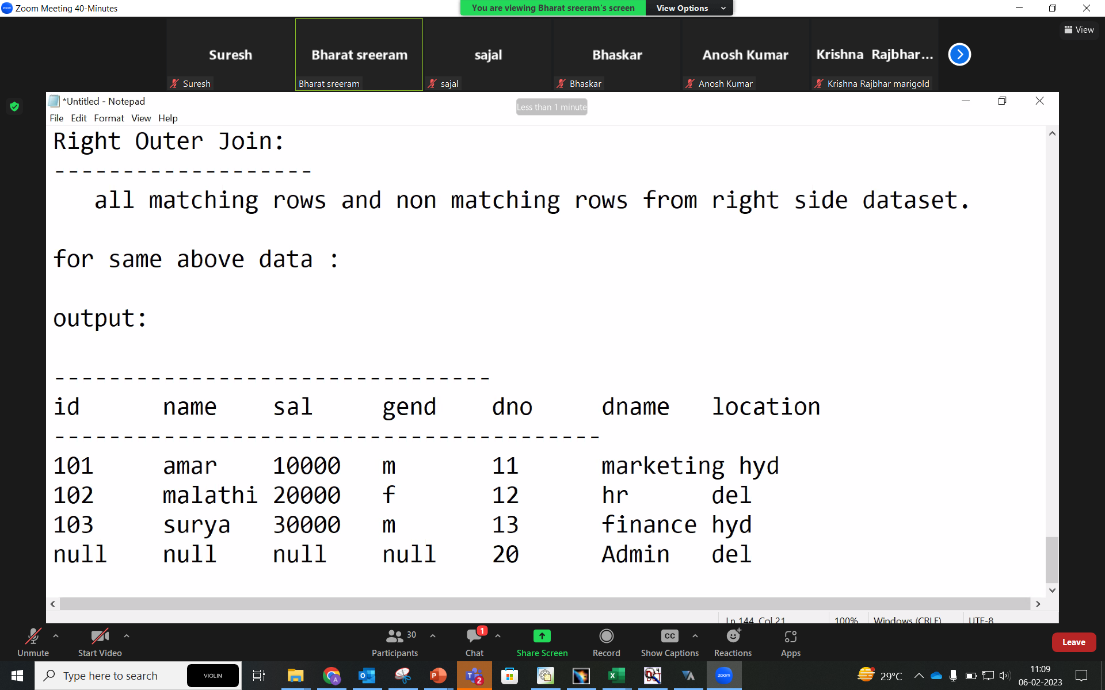
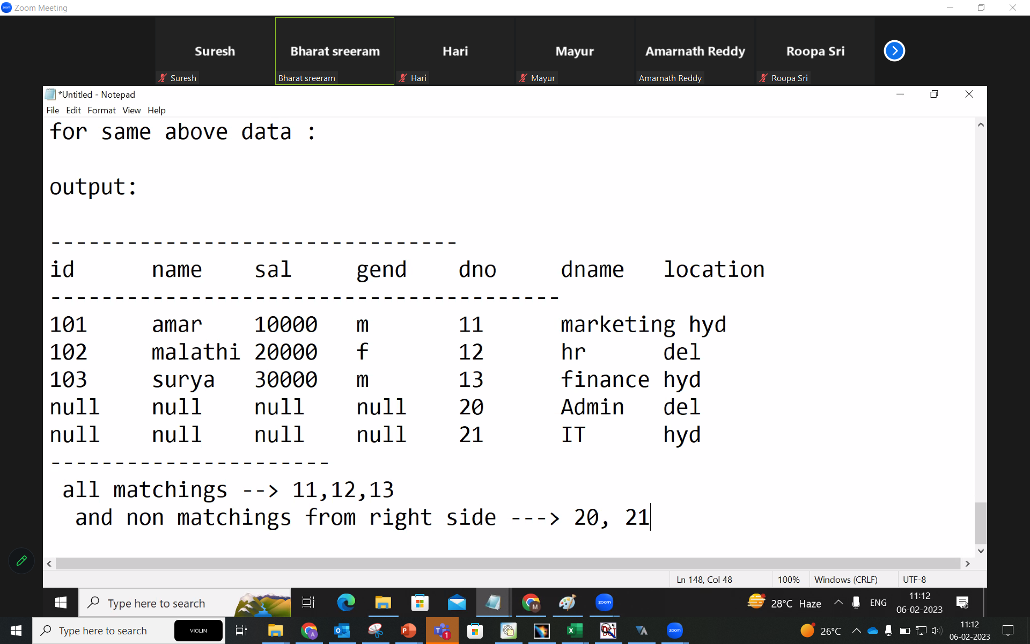
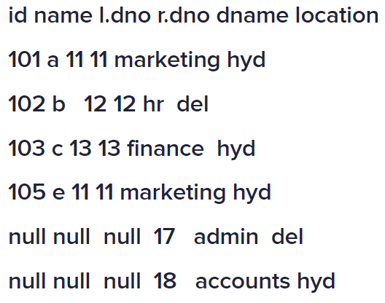

Slide 13
Full JOIN

Slide 14
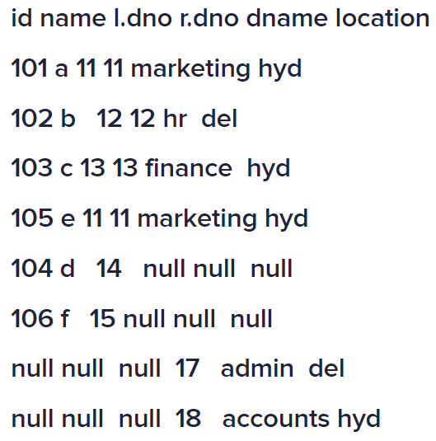

Slide 15
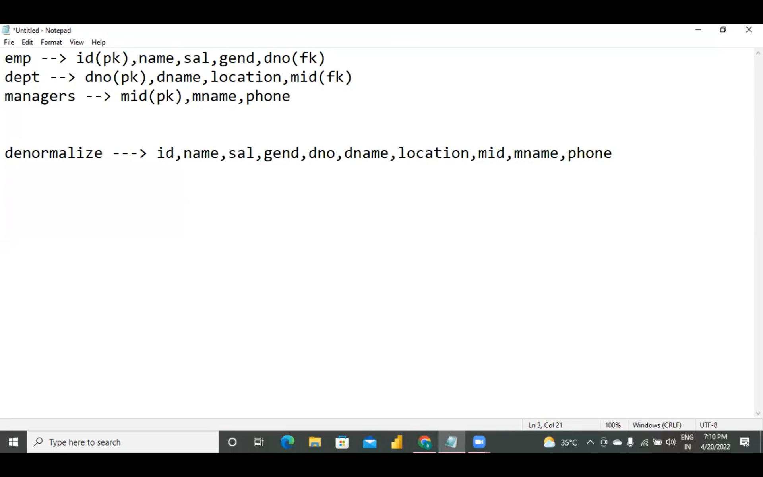
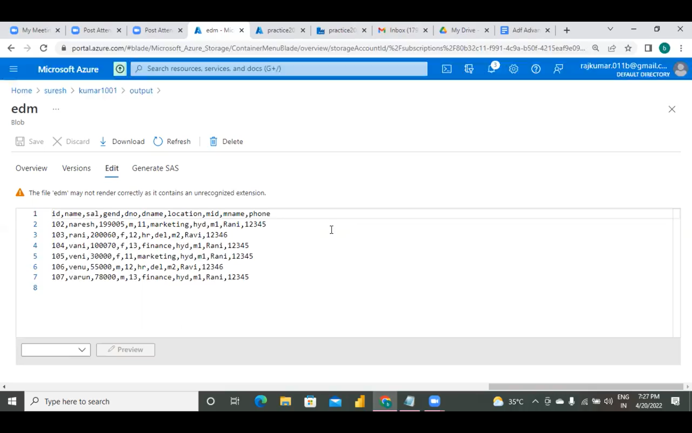
file: emp.txt
-----------------------------------
id,name,sal,gend,dno
101,suresh,100000,m,10
102,naresh,199005,m,11
103,rani,200060,f,12
104,vani,100070,f,13
105,veni,30000,f,11
106,venu,55000,m,12
107,varun,78000,m,13
108,varuna,45000,f,14
file: dept.txt
-------------------------
dno,dname,location
11,marketing,hyd
12,hr,del
13,finance,hyd
17,it,hyd
18,accounts,del
file : manager.txt
--------------------------
mid,mname,phone
m1,Rani,12345
m2,Ravi,12346

Slide 16
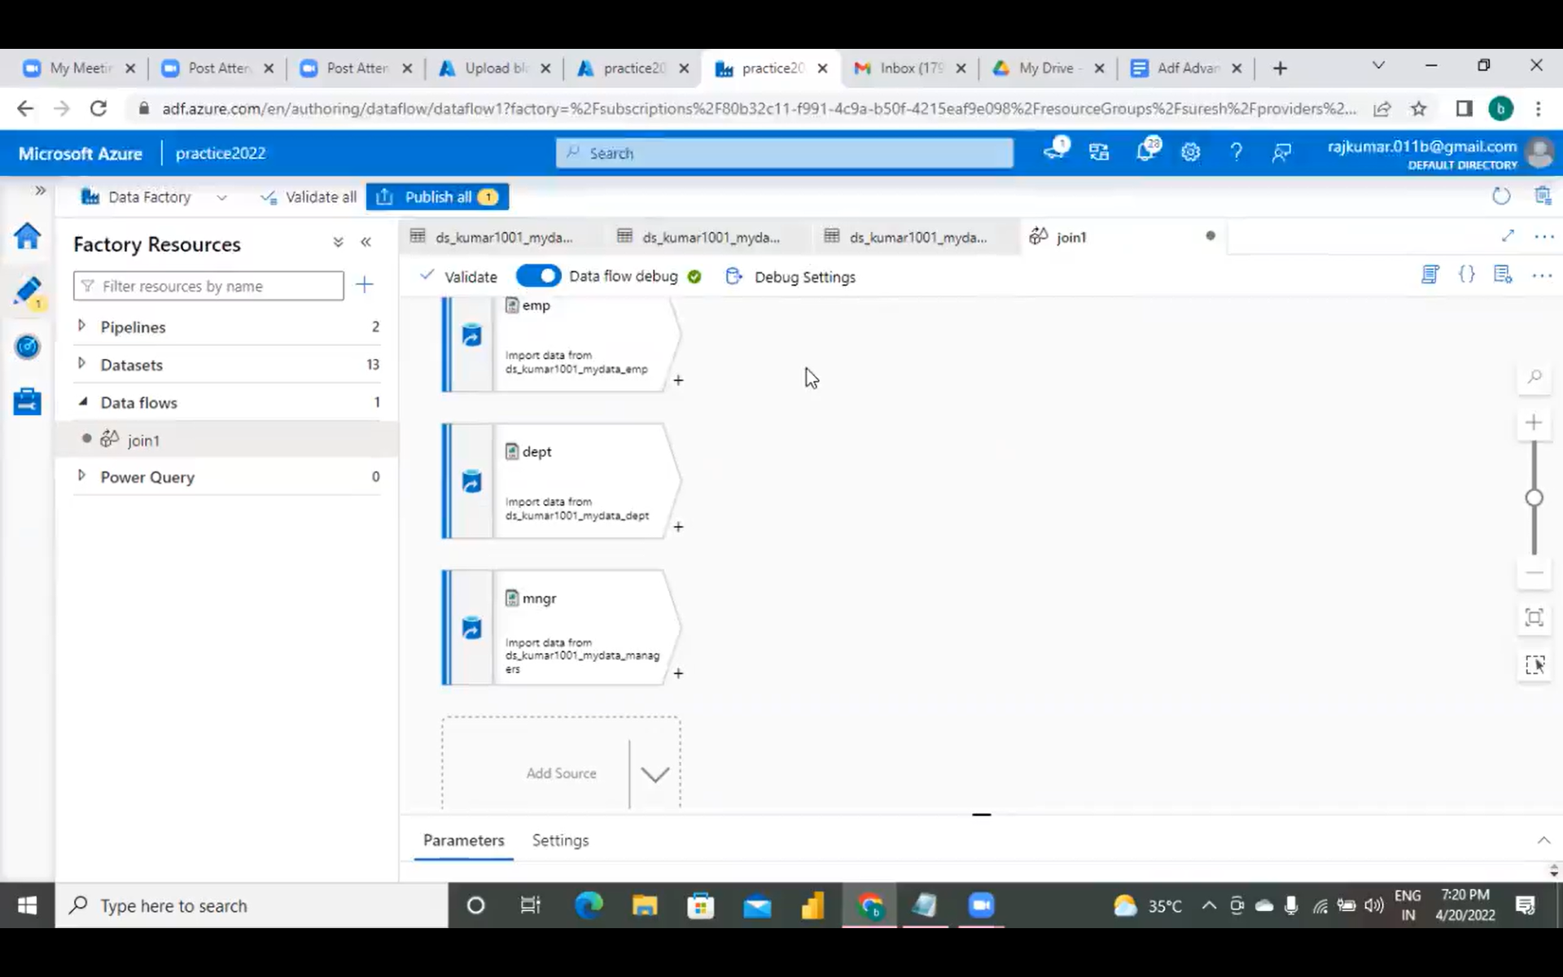
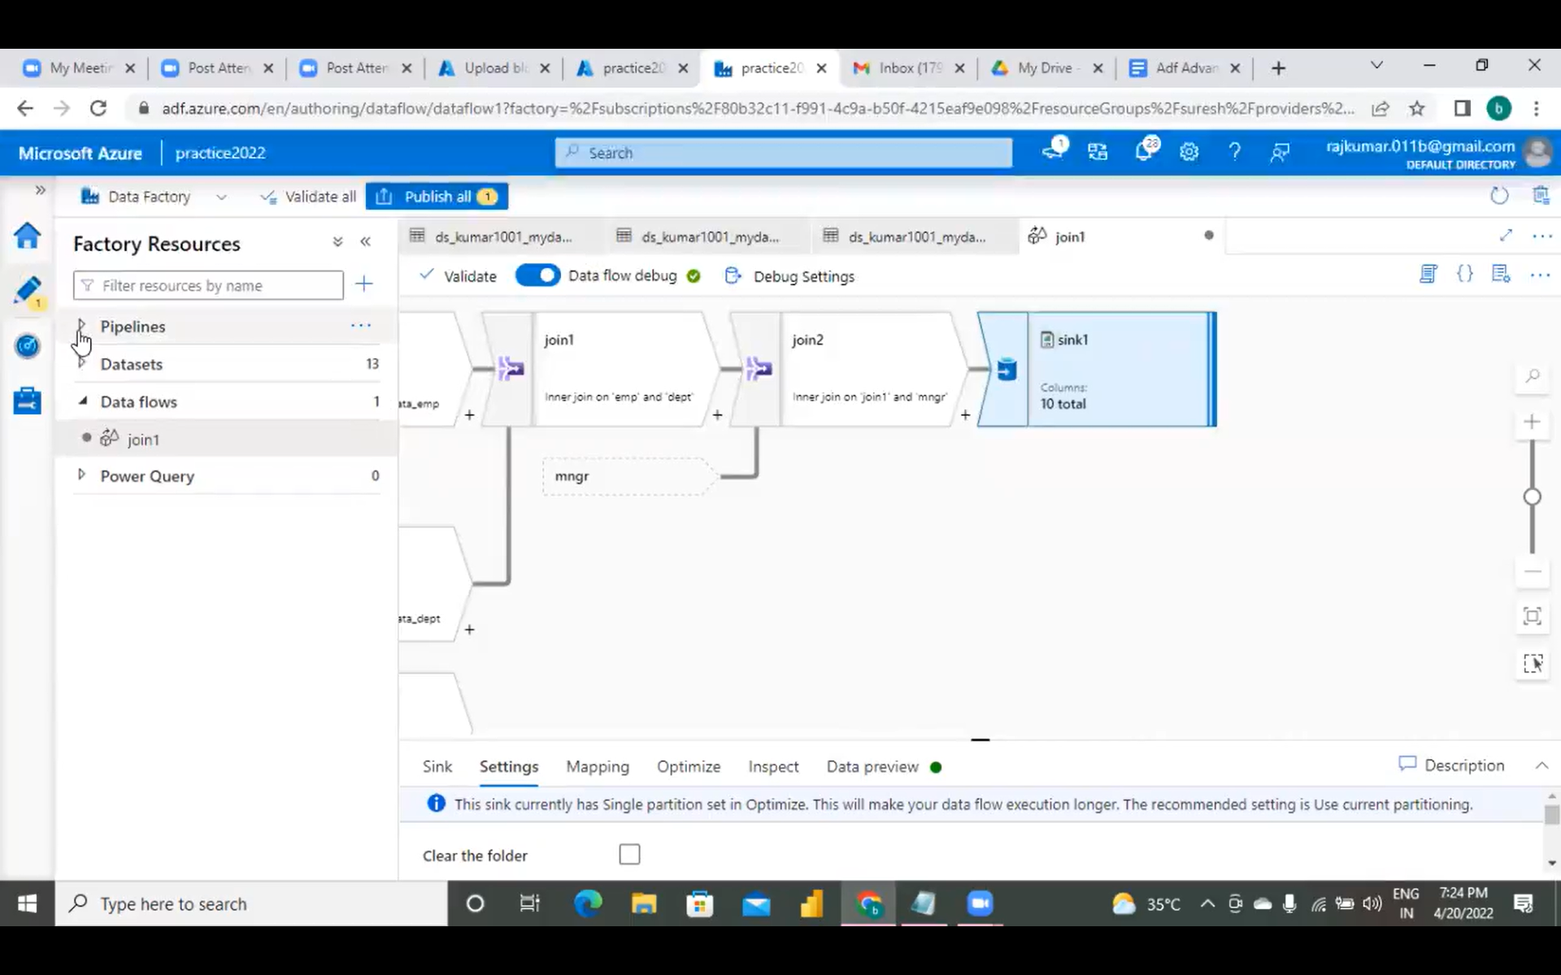

Slide 17
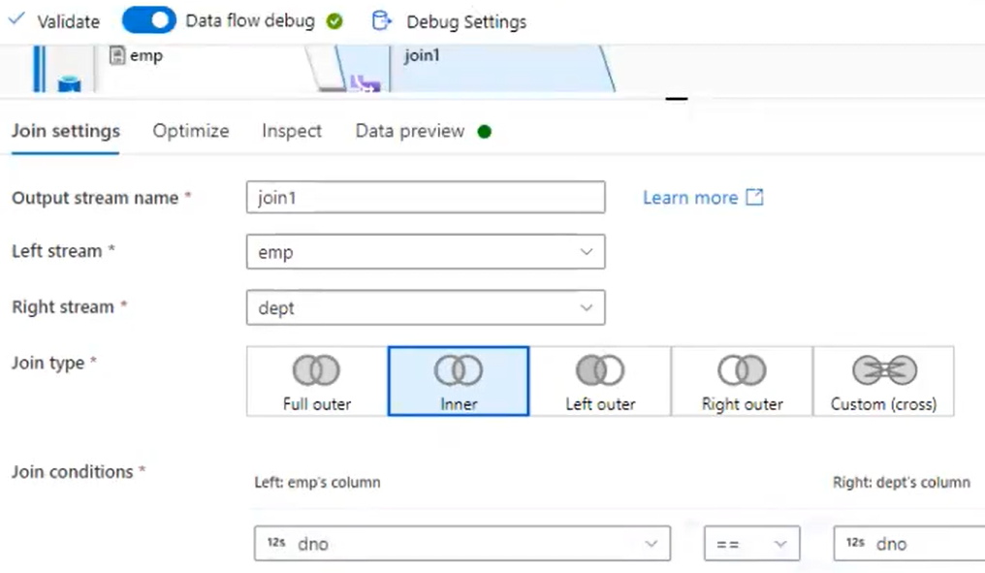
file: emp.txt
-----------------------------------
id,name,sal,gend,dno
101,suresh,100000,m,10
102,naresh,199005,m,11
103,rani,200060,f,12
104,vani,100070,f,13
105,veni,30000,f,11
106,venu,55000,m,12
107,varun,78000,m,13
108,varuna,45000,f,14
file: dept.txt
-------------------------
dno,dname,location,mid
11,marketing,hyd,m1
12,hr,del,m2
13,finance,hyd,m1
Id name sal gend dno dno dname location mid
105 veni 30000 f 11 11 marketing hyd m1
102 naresh 199005 m 11 11 marketing hyd m1
106 venu 55000 m 12 12 hr del m2
rani 200060 f 12 12 hr del m2
varun 78000 m 13 13 finance hyd m1
104 Vani 100070 f 13 13 finance hyd m1

Slide 18
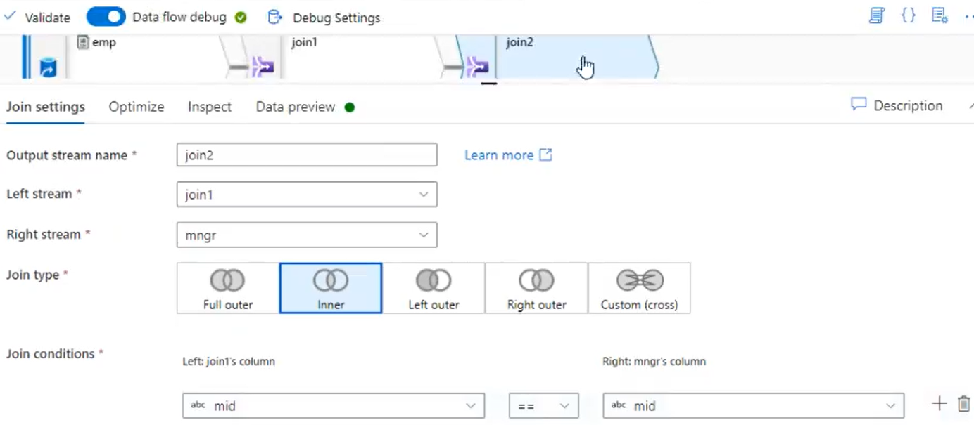
Id name sal gend dno dno dname location mid
105 veni 30000 f 11 11 marketing hyd m1
102 naresh 199005 m 11 11 marketing hyd m1
106 venu 55000 m 12 12 hr del m2
rani 200060 f 12 12 hr del m2
varun 78000 m 13 13 finance hyd m1
104 vani 100070 f 13 13 finance hyd m1
mid mname phone
m1 Rani 12345
m2 Ravi 12346

Slide 19
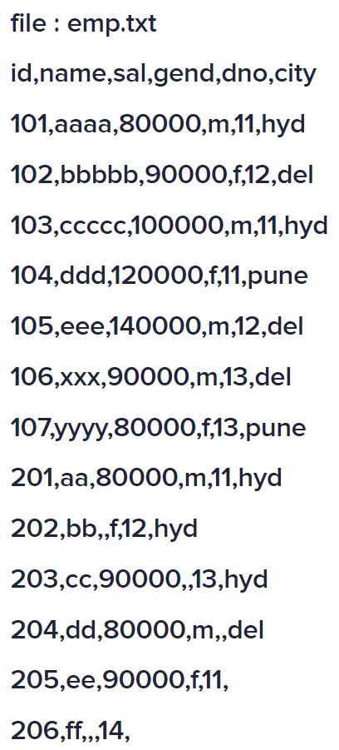
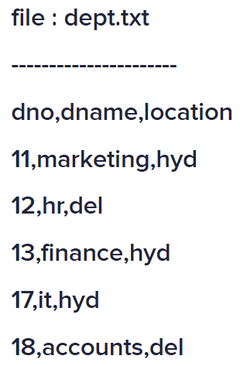

Slide 20
